Slide 1
Alberta ER Wait Times Analysis & Predictive Modeling
Lighthouse Labs Data Science Program Final Project December 2023 Julie Leung
Notes:
Julie
Pleased
Short Summary
Analysis & Predictive Modeling
Alberta ER wait time data

Slide 2
Agenda
01
04
02
05
03
Introduction
Approach
The Inspiration
Results & Interpretation
Data Acquisition

Slide 3
01
Introduction
Notes:
Before diving into the data
A brief introduction about me

Slide 4
20 years in technology
Why Data Science?
software dev | business analysis | architecture
the thrill of deriving insights from data
machine learning and AI are the next frontier for every domain
Notes:
Been working in technology for 20 years in the fields of software development, business analysis, and architecture
I wanted to take a data science program because I find it thrilling to derive actionable insights from data, and wanted to learn how to do it properly
I wanted to upskill to include ML and AI in the next phase of my career

Slide 5
02
The Inspiration

Slide 6
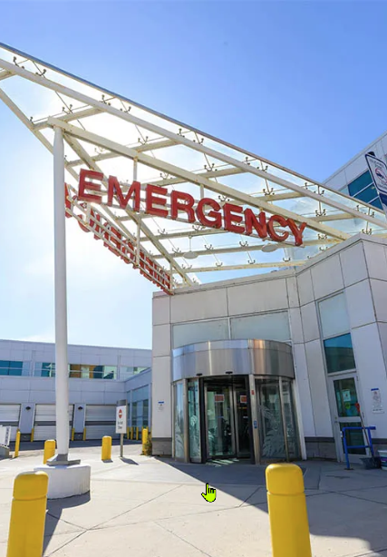
Uncovering ER Wait Time Trends and Patterns
Nurse remark: “ER busier due to time of year and location of hospital”
Question: Are there patterns due to time of year, day of week, or hospital and/or location, city, city population?
Project: What will EDA, hypothesis testing, and feature importances from predictive models show?
Source: https://calgaryherald.com/news/local-news/albertans-say-emergency-room-wait-times-care-quality-declining-survey

Slide 7
03
Data Acquisition

Slide 8
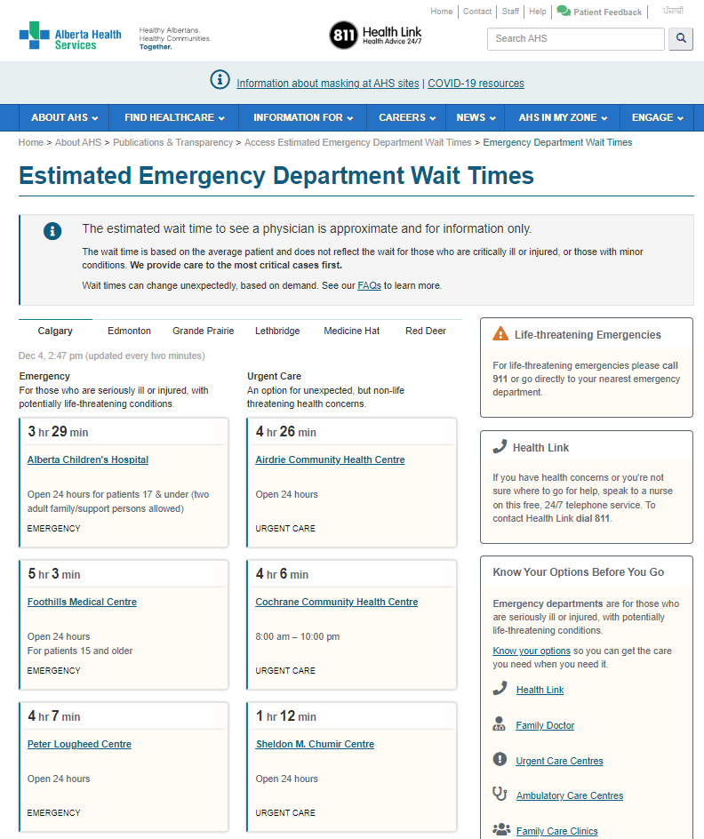
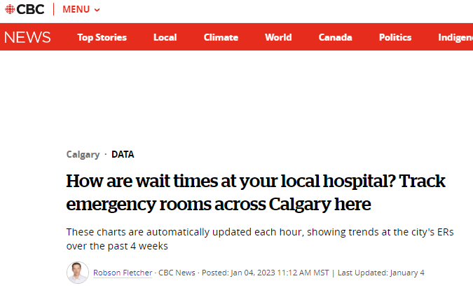
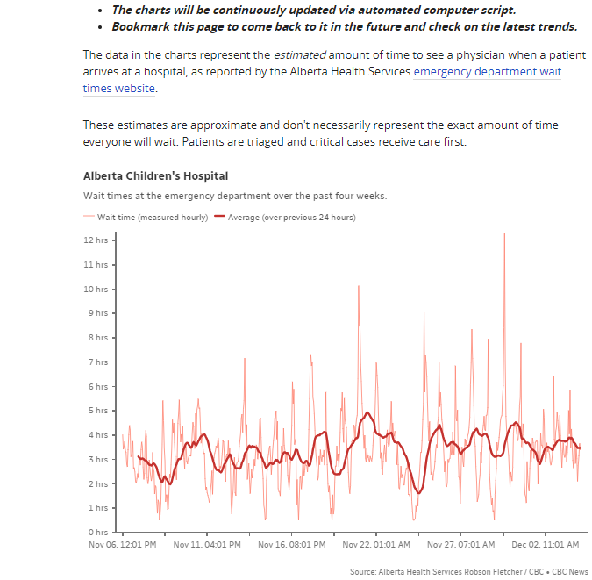
Data Acquisition
AHS Website
CBC Dataset
Collects:
every hour
every hospital
since September 2022
My dataset:
1 year, 2 mos of data
Sept 22, 2022 – November 22, 2023
https://www.albertahealthservices.ca/waittimes/Page14230.aspx
https://www.cbc.ca/news/canada/calgary/calgary-er-wait-time-tracker-cbc-1.6701714
Notes:
Alberta Health Services has website showing estimated ER wait times for every hospital in every city in Alberta
Updates once every 2 minutes
My problem was I could not obtain enough data in the span of 12 weeks
Luckily for me, CBC has been screenscraping this website since September 2022 for their own news articles
I met with them and they agreed to share their raw dataset
CBC records one observation per hospital, per hour
My dataset contains 1 year and 2 months worth of data

Slide 9
04
Approach

Slide 10
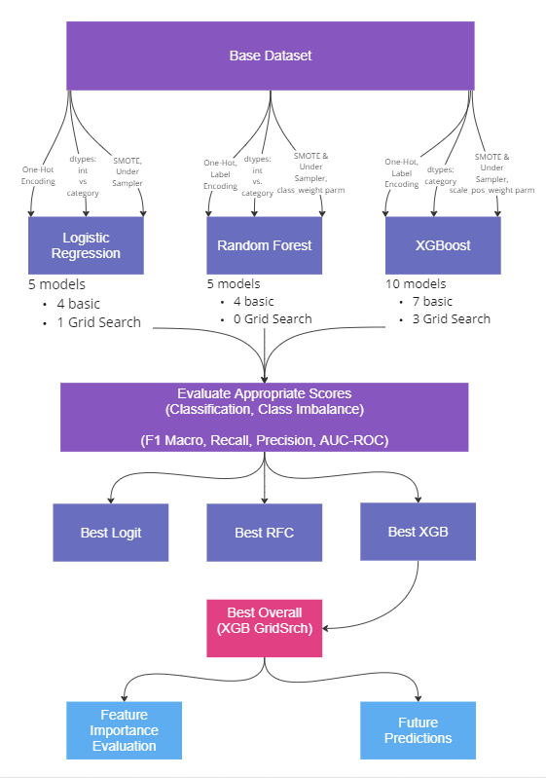
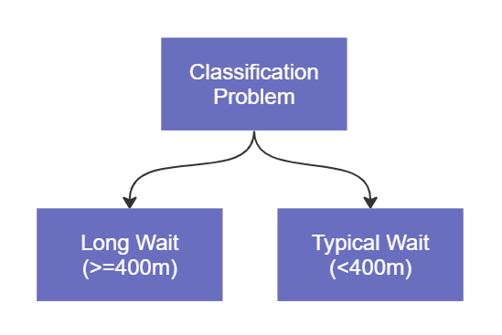
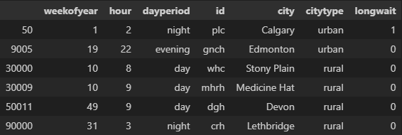
Features
Target
Notes:
Turned problem into classification problem where trying to predict if there will be a long wait or not
Long Wait defined as greater than 400 minutes, based on some national guidelines you can read more about on my GitHub
Here’s a sample of 6 rows of data from my dataset where I have these as features (X variables) and long wait yes (1) or no (0) as target
Process:
Take base dataset and try many different ways of encoding or preprocessing this data
3 classes of model types: simple logistic regression, random forest, XGBoost
Built a total of 20 models
Evaluated each model using appropriate scores for the fact I am doing a classification problem with class imbalance (where there are more 0’s than 1’s in the target variable)
Got the best model from each class, then selected the best of those finalists
It is the red model, was Grid-Searched XGBoost
From there, I can look at the feature importance scores on the red model
The red model can also be used for future predictions or may be useful at a high level for informing staffing decisions or showing specific outlier hospitals to examine further

Slide 11
05
Results & Interpretation
Notes:
From my best “red” model, looked at feature importances

Slide 12
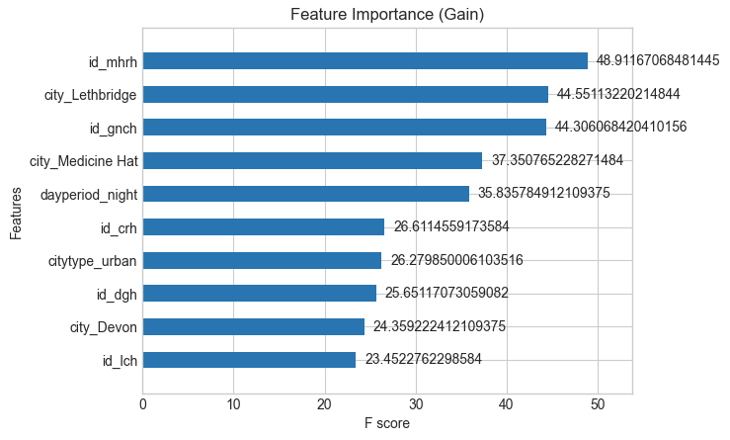
Top 10 Feature Importances
Top 3 important variables
impacting “long wait” or not:
The specific hospital
Period of the Day (“night”) 00h00 – 07h59)
Urban vs. Rural
Notes:
These are the top 10 X variables the model thought were important in building the decision trees to predict whether there will be a long wait
The graph shows that I inadvertently introduced collinearity in some of my features because certain feature pairs indicate the same thing
Something to fix going forward
This is something I would address in future modeling with this dataset
It generally highlighted 3 types of variables that are important in making the prediction:
specific hospital
period of the day
urban vs rural
An increased probability of a long wait time due to location of hospital raises the question about health equity across the province

Slide 13
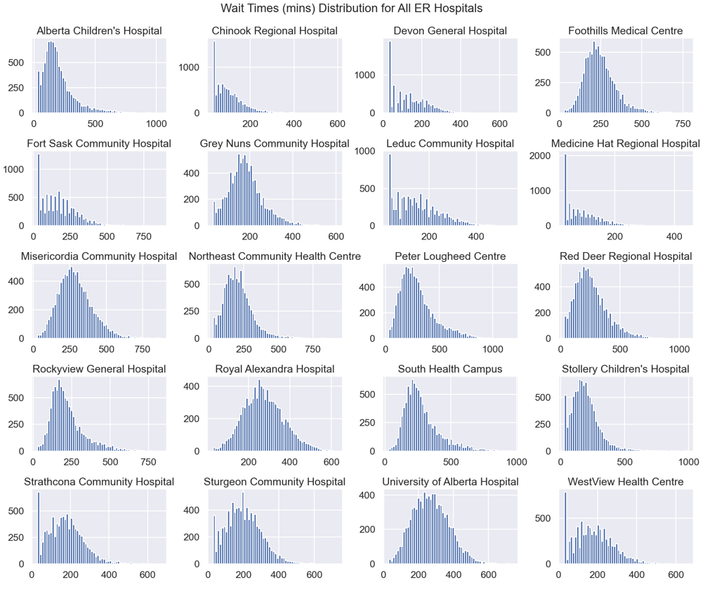
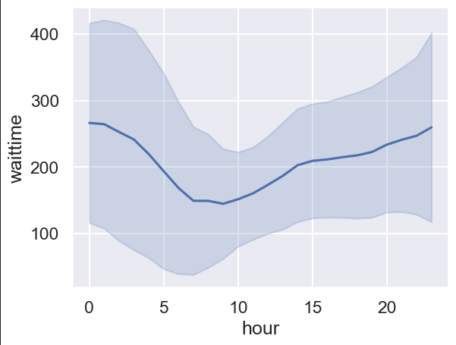
Plots from Exploratory Data Analysis
Confirms trends and patterns observed highlighted by feature importance scores on the model!
Wait Time by Hour for all Hospitals
Night
Day
Evening
Notes:
Model is useful not only for predictions, but also highlighting patterns from the EDA that may not be obvious at first glance
Here is a plot showing distribution of wait times at every hospital
You can see that the feature importances the model pulled out, were the hospitals which do not have > 400m wait times
Also, most of the rural hospitals do not have long wait times
Also highlighted the wait time trend is related to the period of the day, specifically the overnight period

Slide 14
Thank You!
Do you have any questions? More Information and Next Steps at: https://github.com/jtwleung/Final-Project-ER-Wait-Times Connect with me at:
Notes:
I do have more information about future plans for this data on my GitHub and if you have questions, you can also contact me via LinkedIn.
Thank you for your attention and interest

Slide 15
Appendix (Backup Slides)

Slide 16
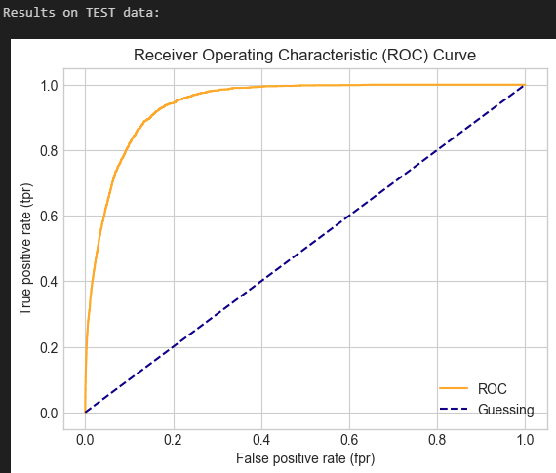
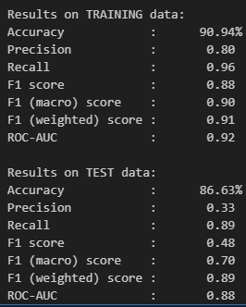
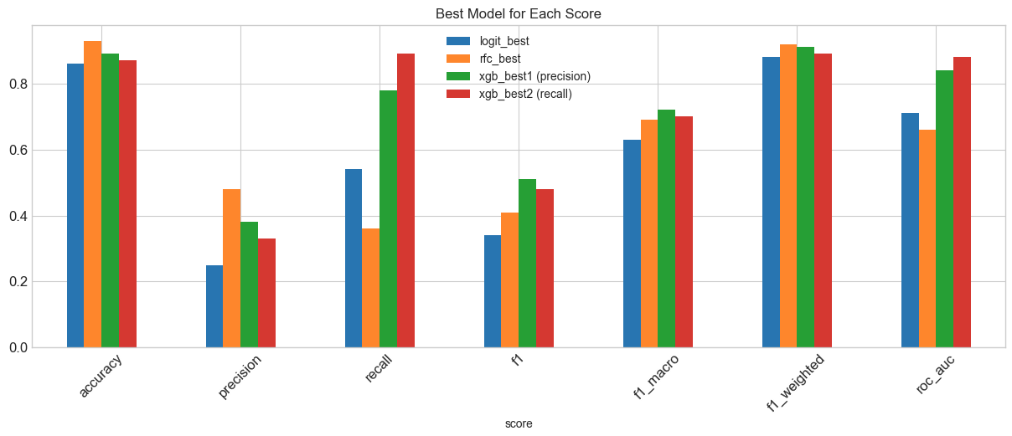
Scores from Best Model
XGB “Best Model” ROC Curve for TEST data
XGB “Best Model” scores on TRAINING vs. TEST data
Comparing Best Model in Logit, RFC and 2 XGG:

Slide 17
Future Plans
Re-factor problem statement and data to be “Predict wait time is > mean wait time”
Or “> 3 hours” (which is CAEP 90th percentile guideline)
Predictions will be more useful
Mitigates class imbalance problem
Remove collinear data altogether:
City (determined by hospital)
City Type (determined by hospital)
Day Period (determined by hour)
Re-train on data including July
Build a model for each hospital
Possibilities for Further Analysis
Generate generic input data set with a row for each hour of each day of each week for each hospital and use with re-built model(s) to:
get model.predict_proba() columns (‘probability of 0’ and ‘probability of 1’) :
generate line graph of changing probabilities by hour, by day, or by week per hospital
generate bar graphs of mean probability of long wait, per city, per hospital
count number of incidences of > 80% or 90% probability of long wait and take percentages per week, month, etc. and see which hospitals are highest

Slide 18


